Slide 1
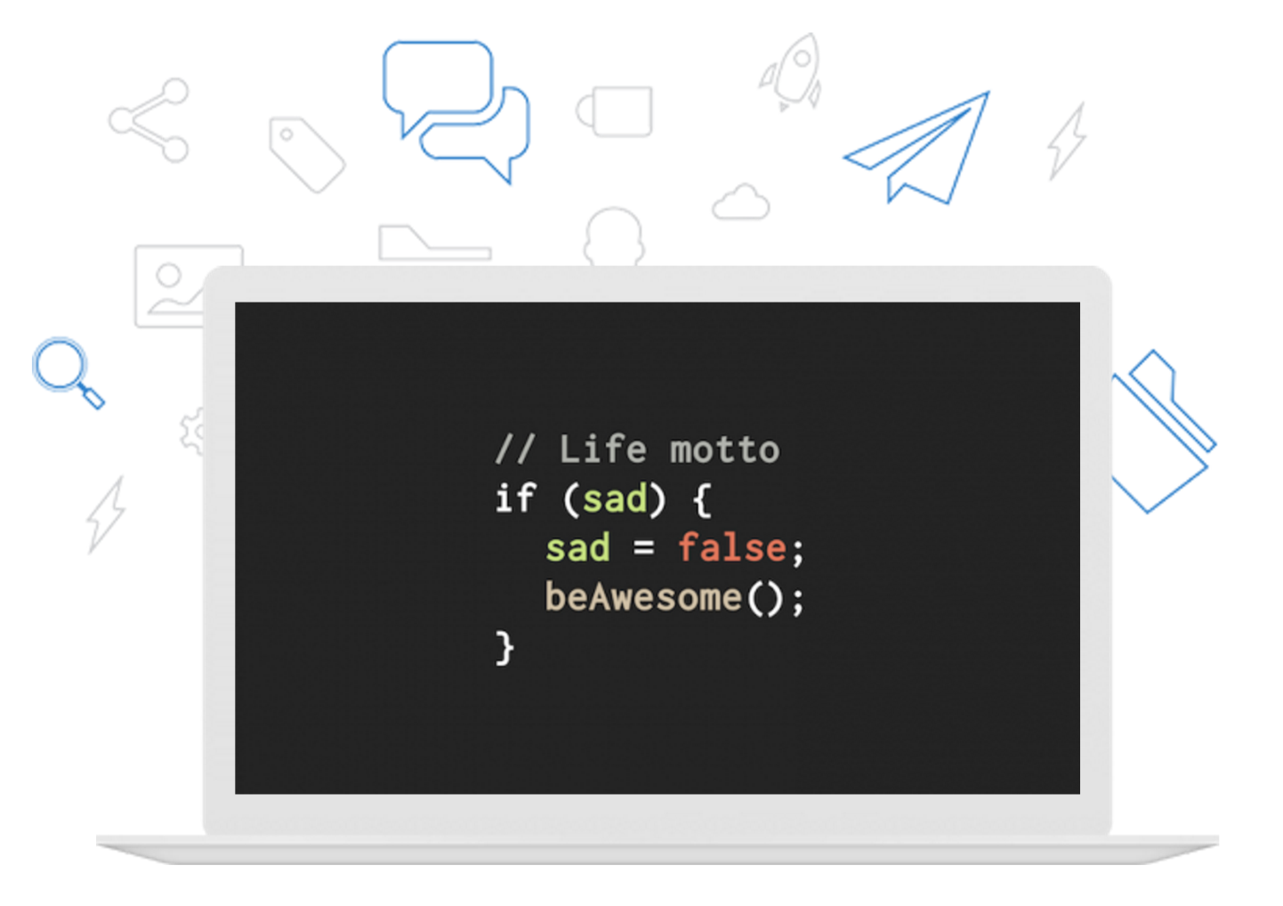
Welcome to DFW Code Camp!
Notes:
Hi – Welcome to our very first weekend code camp
I’m Tony, the organizer and one of your mentors.
If you’re new to web development, or looking for a refresher on the basics – you’re in the right place!

Slide 2


Thanks to Our Sponsors!
Notes:
Big thank you to rewardStyle for allowing us to host our event in their beautiful office
And a big thank you to our friends at The Iron Yard for feeding us today!

Slide 3
Today’s Schedule
Welcome
Overview of Web Programming (Talk)
Hands-On Workshops
Lunch
MOAR Hands-on Workshops
Sunday?
Notes:
Basic outline for today
Go through list
Sunday: TBD
Depending on what we get done: overflow / bonus

Slide 4
General Info
Wifi
Name: rsGuest
password: rewardSyle
Bathrooms
Chrome Installed

Slide 5
Getting The Most Out Of This Weekend
Getting Comfortable with Being Uncomfortable
Ask Questions!
Open Learning Environment
Notes:
I wanna take a minute to talk about how to get the most out of this weekend
Learning is fun! Right?
But it can also be stressful – especially if it’s something unfamiliar (new)
You may feel that way at some point – maybe even this weekend.
It’s perfectly normal!
Happens to everyone – even veteran programmers.
Getting Comfortable with Being Uncomfortable means…
being ok with the stress that sometimes comes with learning something new (growth)
When you’re in your comfort zone are you growing or learning? Probably not.
Successful Programmers: Perpetual State of growth
They’re always learning something
As you go through this weekend, if you feel uneasy – don’t be discouraged.
We’re here to help!!
Please Ask Questions!
Introduce mentors around the room: Jonathan, Douglas, Austin
These guys are top notch, so take advantage their expertise
Open Learning Environment
We encourage collaboration with your peers (neighbors)
Pair up if you want!
If you have experience and would like to help people who need it – we encourage that.
Questions? Thoughts? Addendums?

Slide 6
Overview of Web Programming
Computer Networks
Network Protocols
Web History
HTTP and The Web
Web Servers & Databases
Client-Side Technologies
Notes:
Before we dive into hands-on stuff we want to give you a little background (context)
Give you a bigger picture of how things fit together
Outline
Computer Networks - devices connected together
Network protocols – enable communication on networks
1 Minute Web History
HTTP high points and examples
Web Servers & Databases – only brief mention since this class is all about client side programming
Client Side Tech

Slide 7
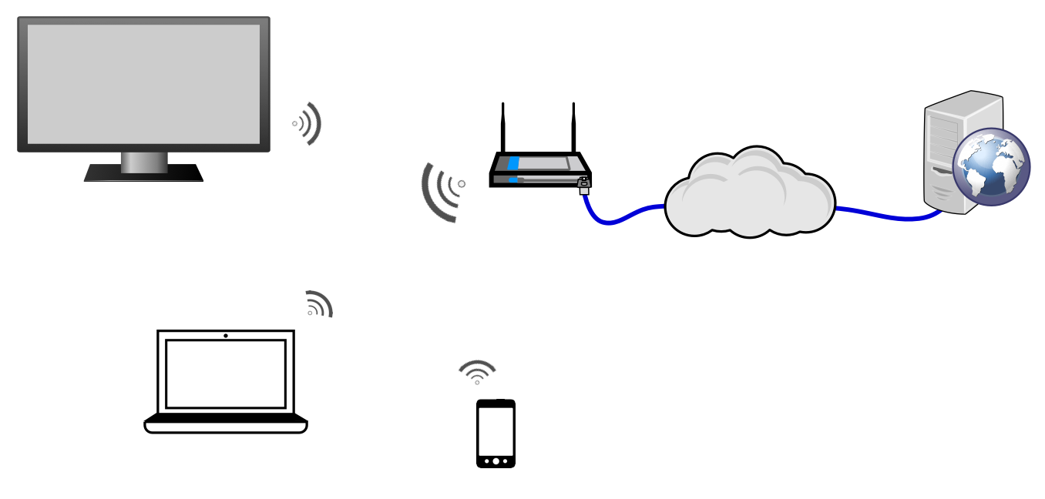
Computer Networks
Notes:
Computer networks are groups of computers and other devices, connected together for the purpose of exchanging information (e.g. they can “talk” to each other).
Explain diagram
Wifi Network
Cloud: Represents lots of "stuff" - connections
Cloud: "yadda yadda"
Without networks there would be no Internet, no web, and no web development.
So, we’re going to talk a bit about how networks relevant to web programming.

Slide 8
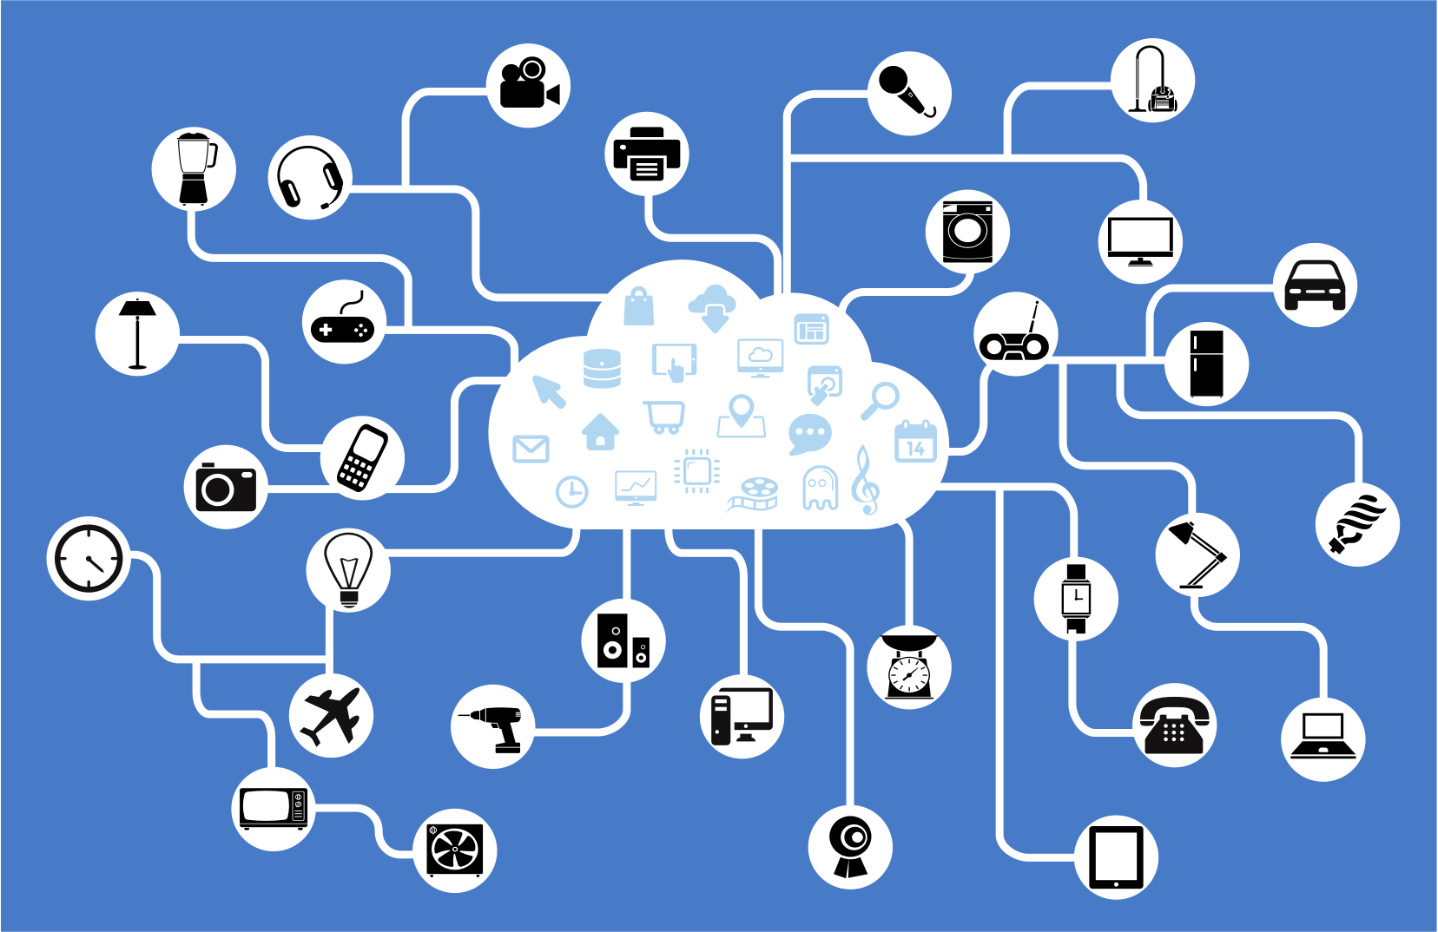
Notes:
The Internet is a worldwide network made up of billions of devices, and other networks.
Can you imagine billions of devices trying to talk to other devices at the same time?
It might be something like to trying to pass a message to your friend on the other side of a crowded concert hall.

Slide 9
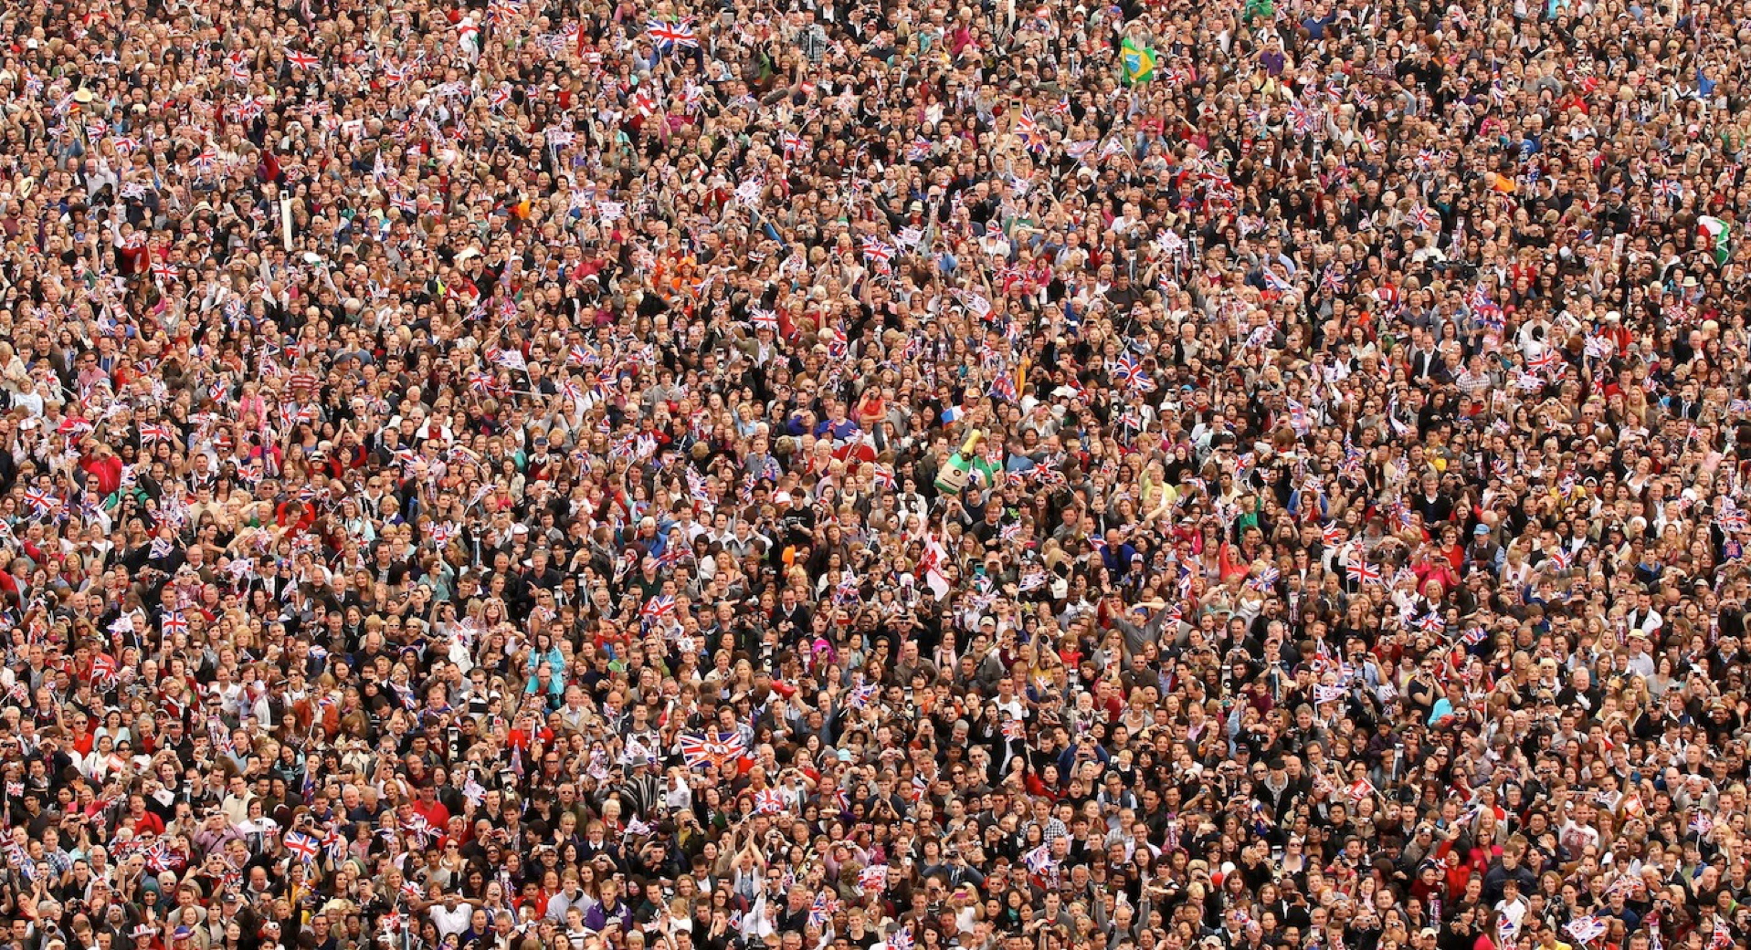
Notes:
It would be chaotic.
To get your message delivered without walking it over yourself, you’d need others in the hall to cooperate and follow certain rules
So...we need rules.
What’s another challenge you might face?
Hint: Imagine the concert has people from all over the world.
You’d also need to agree on a common language to speak.
So we need a set of rules and a common language. That’s where protocols come in.

Slide 10
Network Protocol
Set of Rules
Common Language
Notes:
A network protocol is essentially a set of rules and a common language that devices on a network use to communicate with each other.

Slide 11
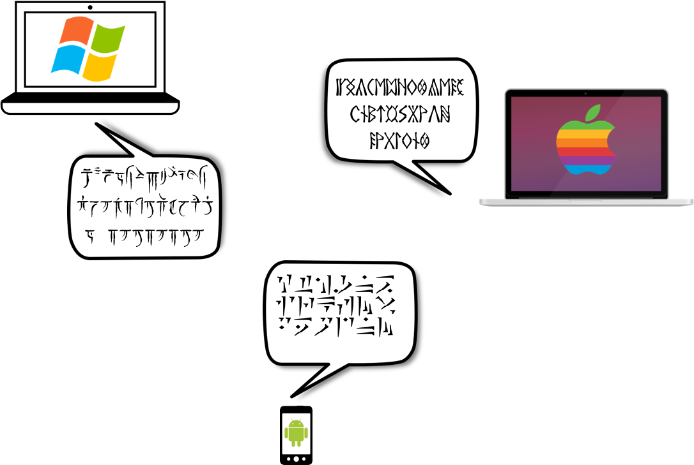

Without Protocols
Notes:
Without protocols, it would be more difficult for different types of devices to communicate.
For instance: Apple, Windows, & Android might not understand each other

Slide 12
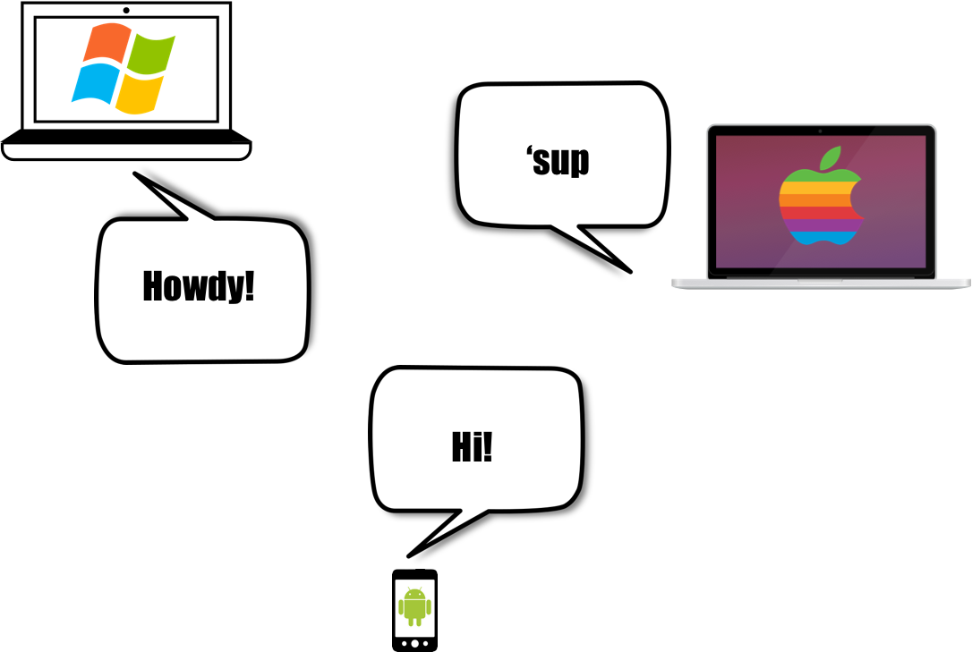

With Protocols!
Notes:
So that’s briefly why network protocols exist: common language and rules for communication

Slide 13
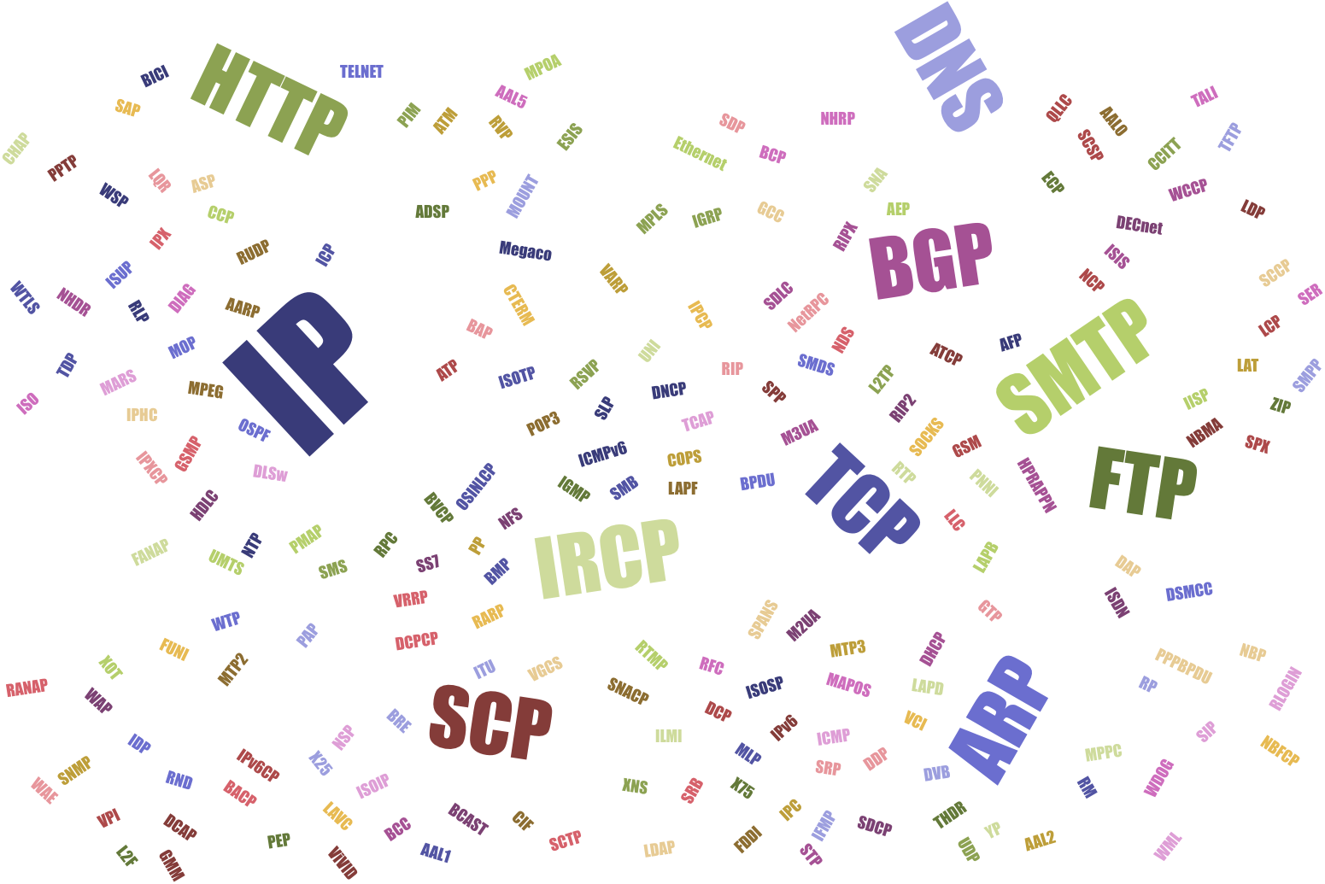
Notes:
There are tons of networking protocols being used on the Internet for various things, e.g.
Mail delivery
File transfer
Chat

Slide 14
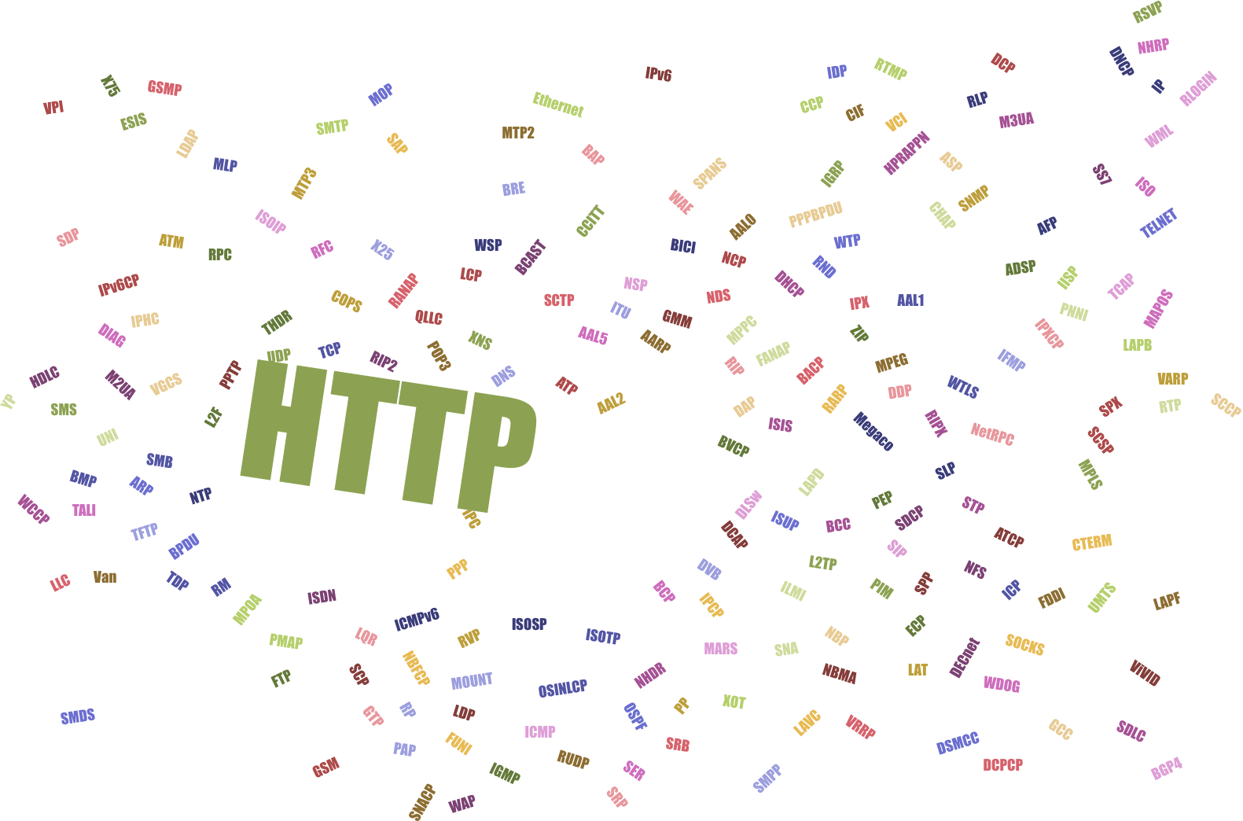
HyperText Transfer Protocol
Notes:
But the one we care about today is HTTP
In a nutshell, HTTP is the protocol of The Web.
So, what does that mean?
Basically it’s the protocol that’s used to view and use web applications.

Slide 15
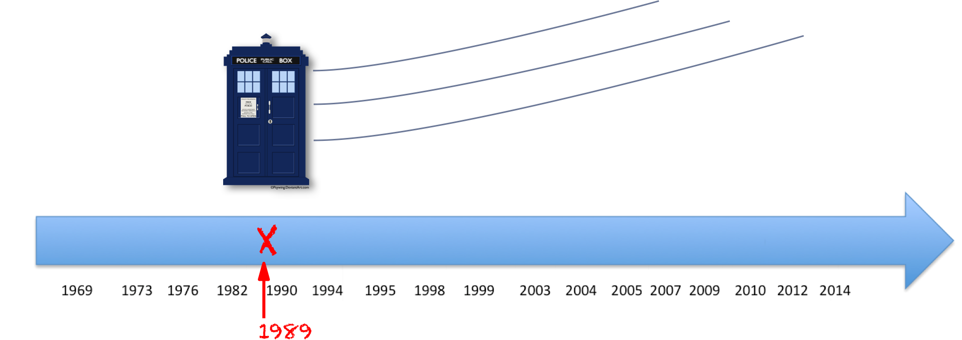
Notes:
But before we get into the details - let’s take a quick ride in the wayback machine...

Slide 16
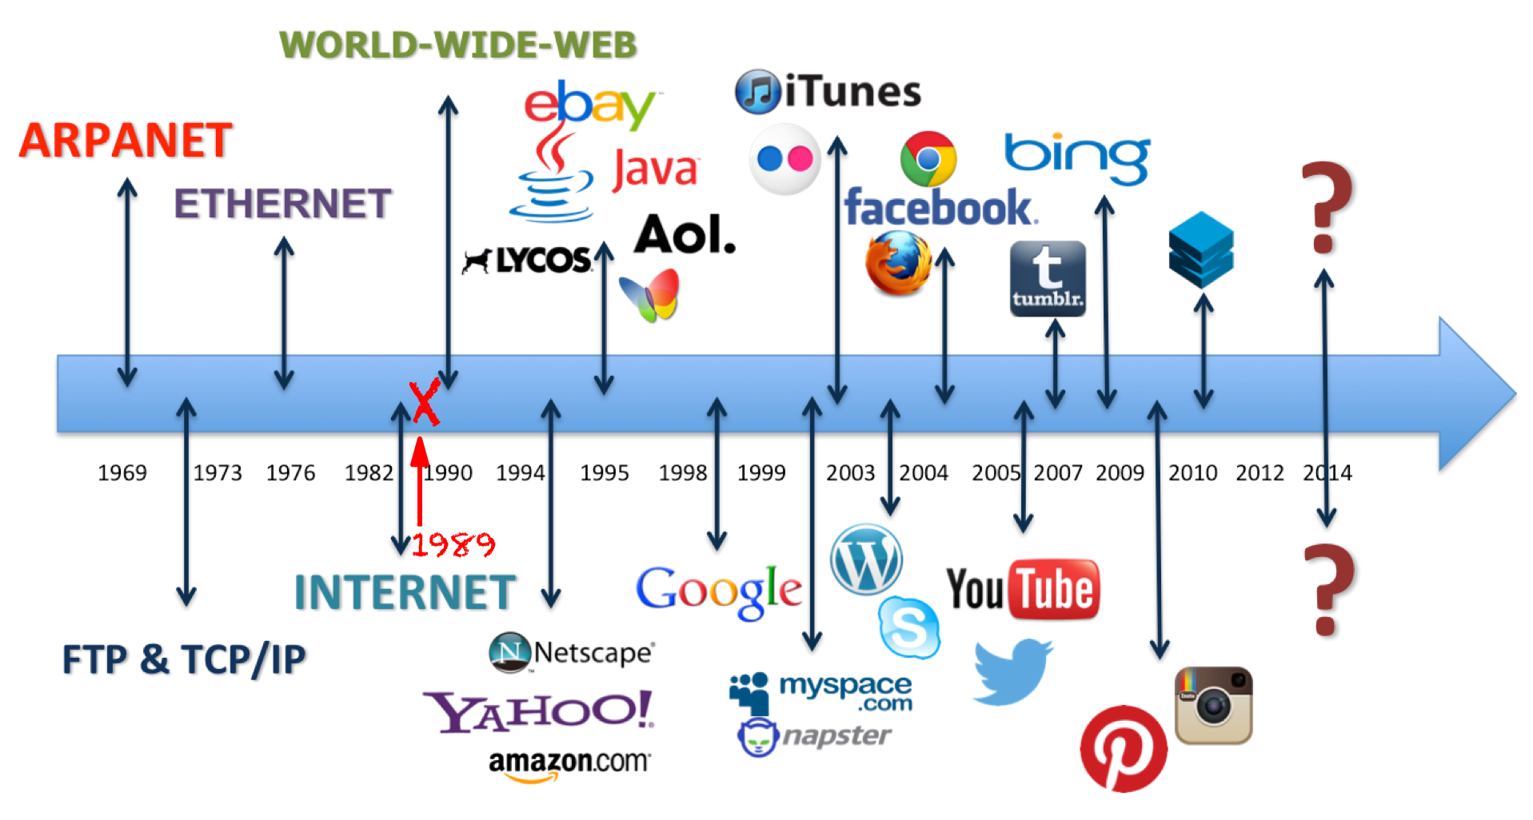
Notes:
…Back to 1989 when HTTP and The Web were both created.

Slide 17
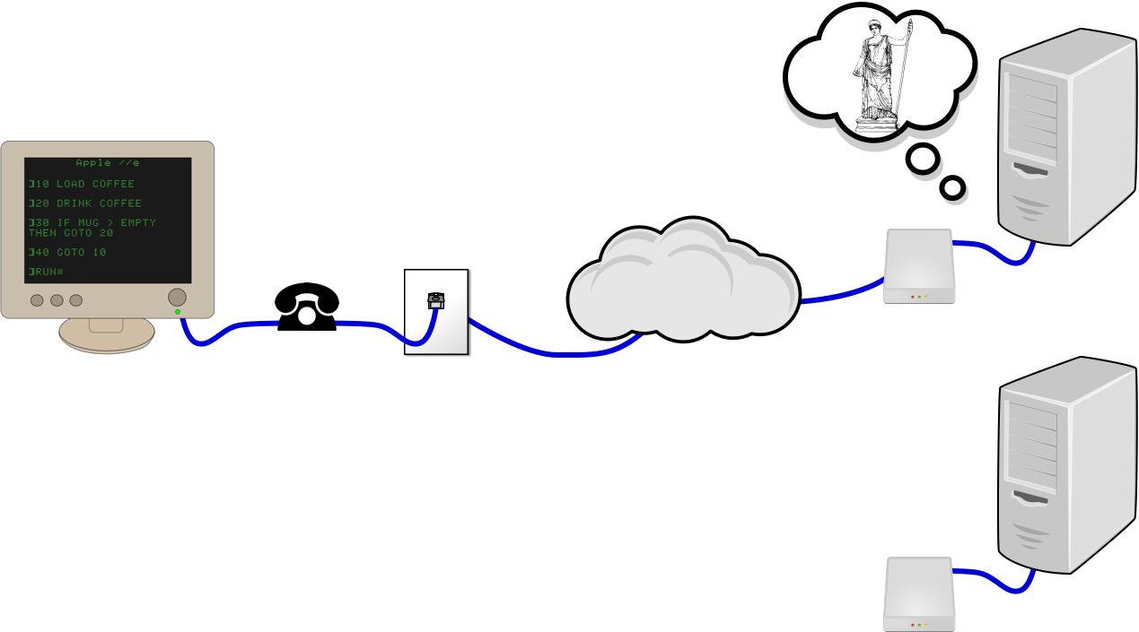
Notes:
Researchers wanted a better way to share their publications and research.
Prior to The Web, academic publications were more disconnected.
They might contain references to other pubs
But you couldn’t just click on them and go there
They wanted a way to link directly and navigate to other publications from within their own.
So they (Tim Berners-Lee) created The WWW and HTTP.
The first “web applications” were pretty bare bones…

Slide 18
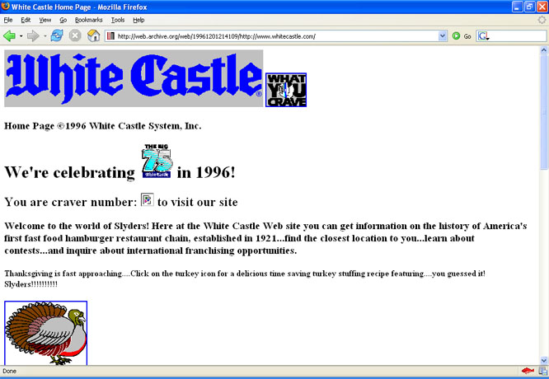
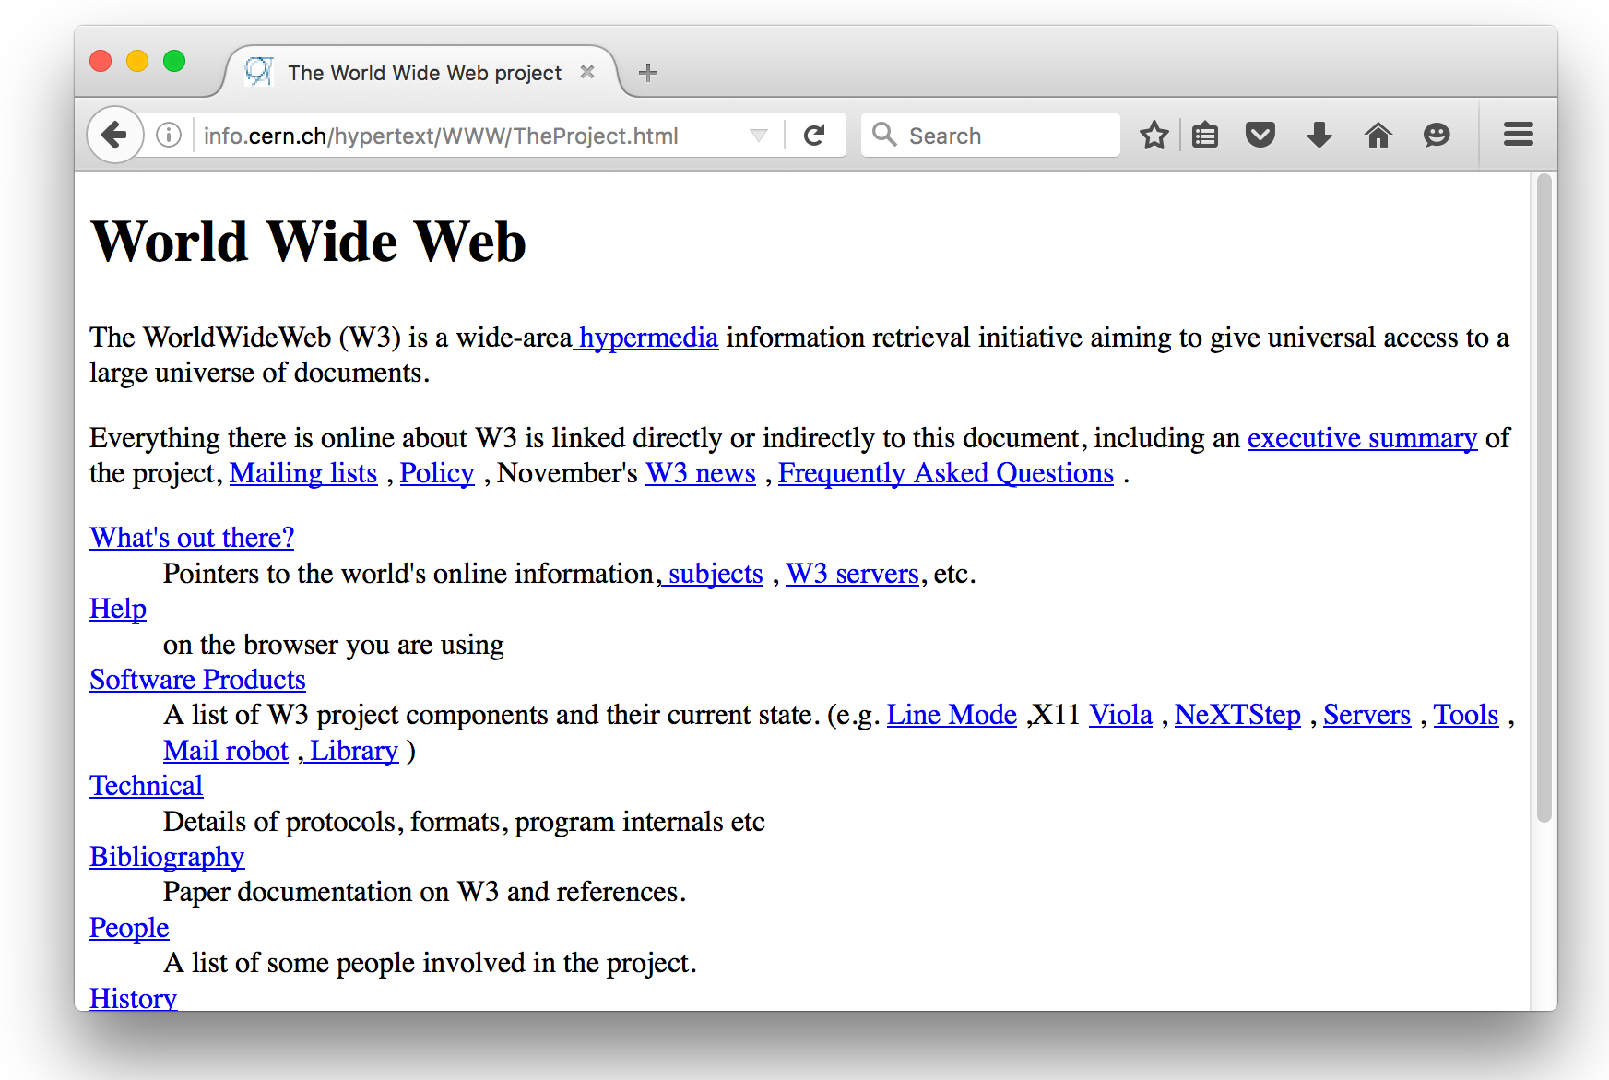
Notes:
Early web pages were little more than text with hyperlinks (aka “links”), which is known as Hypertext (hence the “HyperText” in HTTP).
The bottom right page was the first web page (CERN: European Nuclear Research Organization).
White Castle (from 90s)
You can see that things have changed dramatically since then.

Slide 19
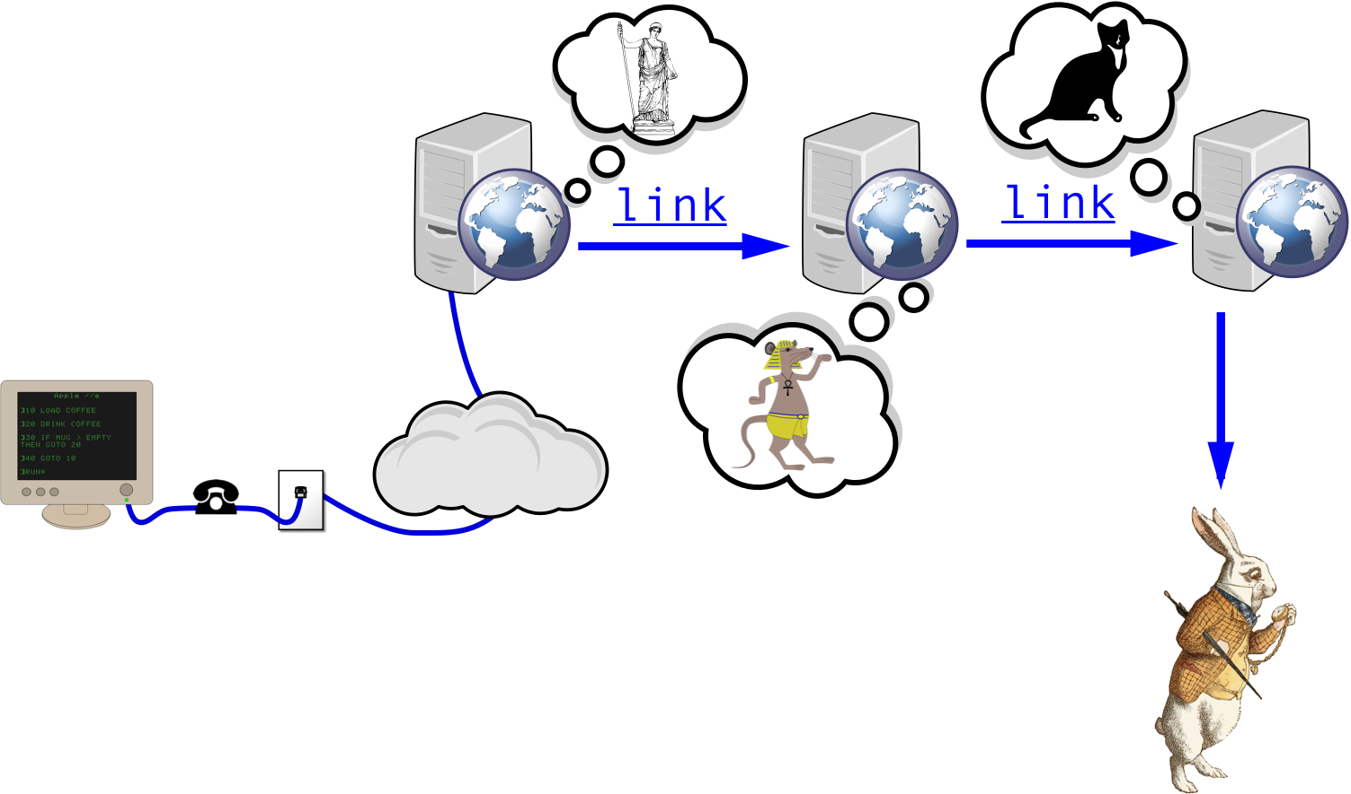
Notes:
After The Web, things looked more like this
Jump on computer and dial into AOL or other internet provider.
You could be reading about Roman history
and then click a link about Ancient Egypt to read about Pharaohs and their pets
And of course you end up looking at cat pictures at some point
And so on and so forth…

Slide 20

Notes:
Until you find yourself falling down the all-too familiar rabbit hole of links on the web
That’s The Web we’ve come to know and love

Slide 21
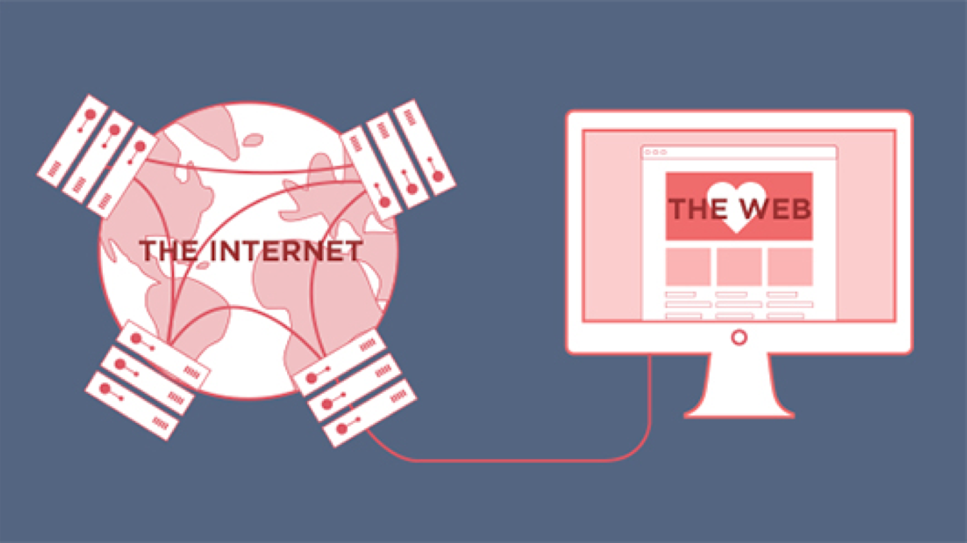
HTTP
Notes:
Bringing it back
I said HTTP was the protocol that’s used to use web applications.
The implication here is The Internet is much larger and multi-purposed (than just web browsing)
There are all kinds of traffic floating around The Internet using various protocols, including HTTP
Think of your web browser as a filter on (window into) The Internet that only speaks HTTP
Because HTTP is so integral to the web, it’s important for web developers to have at least a basic idea of what it is and how it works.
You can kinda get by without it, but if you’re interested in a career in web development you’ll eventually want to get more familiar with it.
Cover some high points and then we’ll move on
Questions?

Slide 22
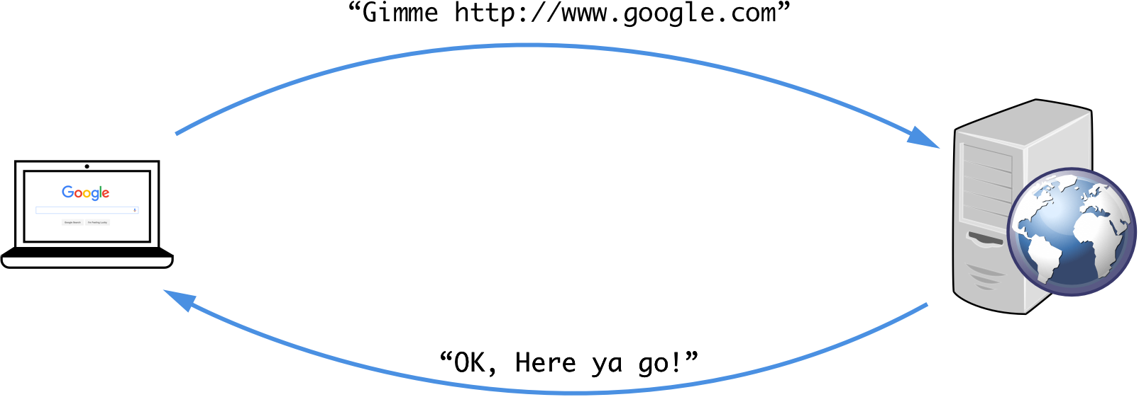
Notes:
As protocols go, HTTP is a pretty simple one.
When you type google.com into your browser it sends out an HTTP request for a web application and then waits for the response (until timeout – gives up).
Example
Requests google.com from web server (computer that hosts the site) out there somewhere
Server responds with the web application
This obviously isn’t the actual language it uses
Remember that protocols are part rules and part LANGUAGE
So you there must be some vocabulary (or words) in this language

Slide 23
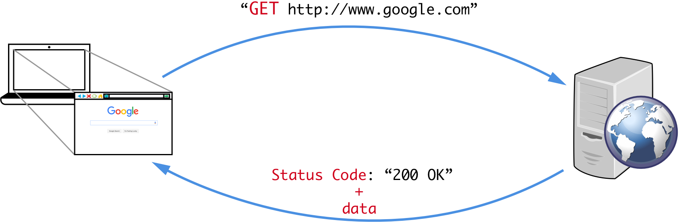
Notes:
GET is one of those words and it simply means “Give me this web page”
Example
GET google.com
The web server (computer) receives the request and sends back the response
RESPONSE
Status Code (outcome of the request)
Data
Browser Translates data and displays on screen
Questions?
OK - Let’s look at another, more interesting example: Logging in to a web application

Slide 24
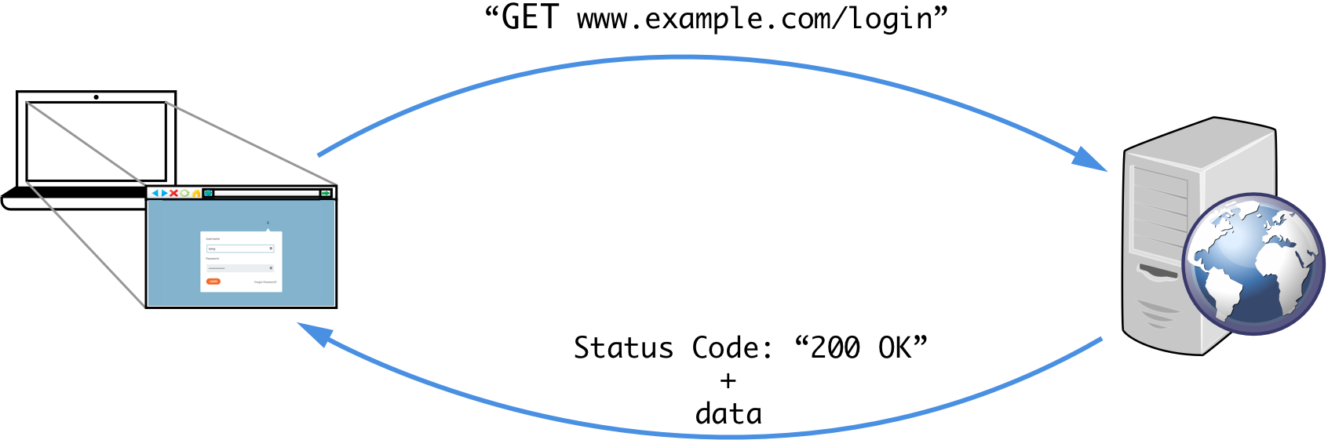
Notes:
Let’s say I want to log in to a hypothetical website
The first thing you do: put the URL into your web browser and go
That sends a GET request to the server that hosts www.example.com/login
Server responds with status code & data used to render the login page
Remember, this is the login page. We still have work to do to log in

Slide 25
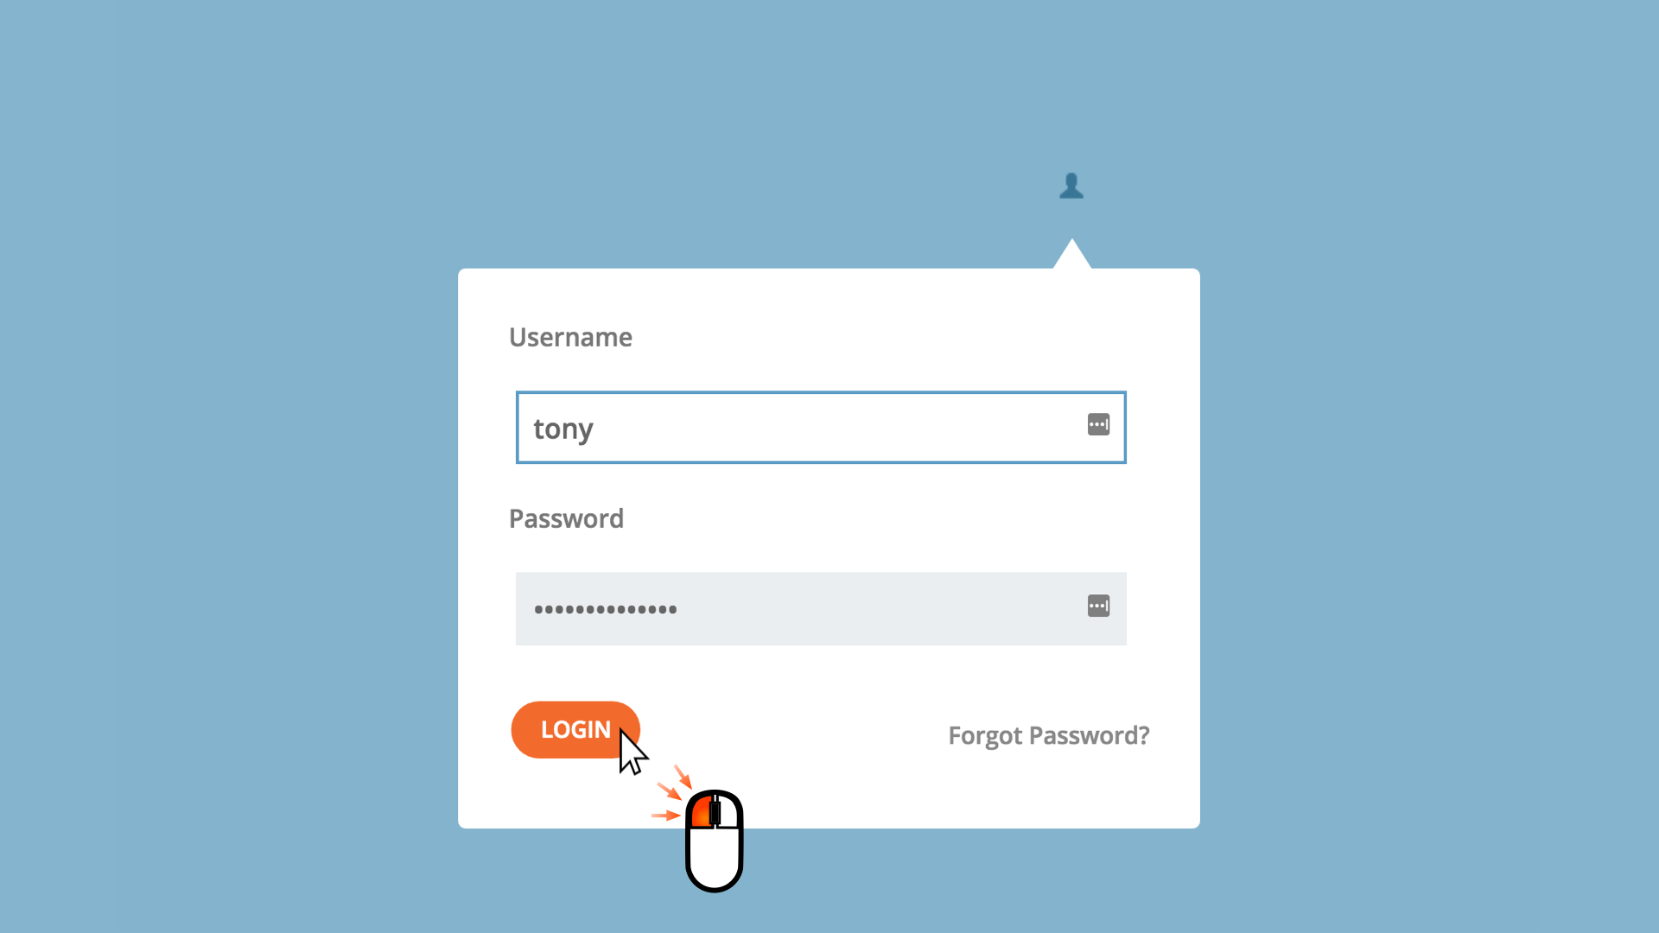
Notes:
Obviously you’d enter your username and password and click the Login button
And that sends another, different type of request to the web server

Slide 26
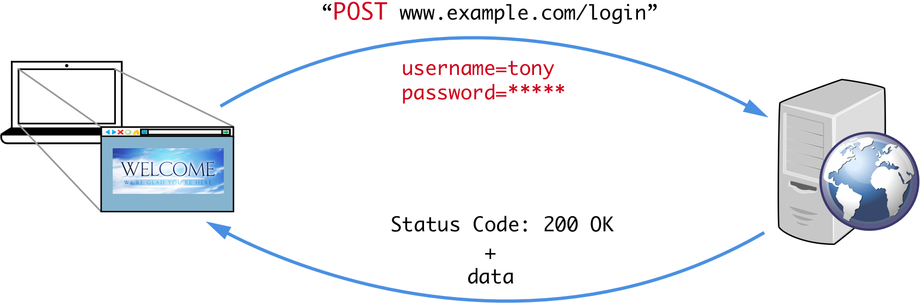
Notes:
POST is another word in the HTTP protocol language
If GET is asking to be sent something POST is sending something
In this case, it’s sending your login credentials to the web server.
The web server will verify your credentials and reply
If your credentials we’re good (this example) Server responds with
200 OK status
The landing page of example.com (or whatever the post login page is)
Questions?
So, what happens when you type in a URL that doesn’t exist?

Slide 27
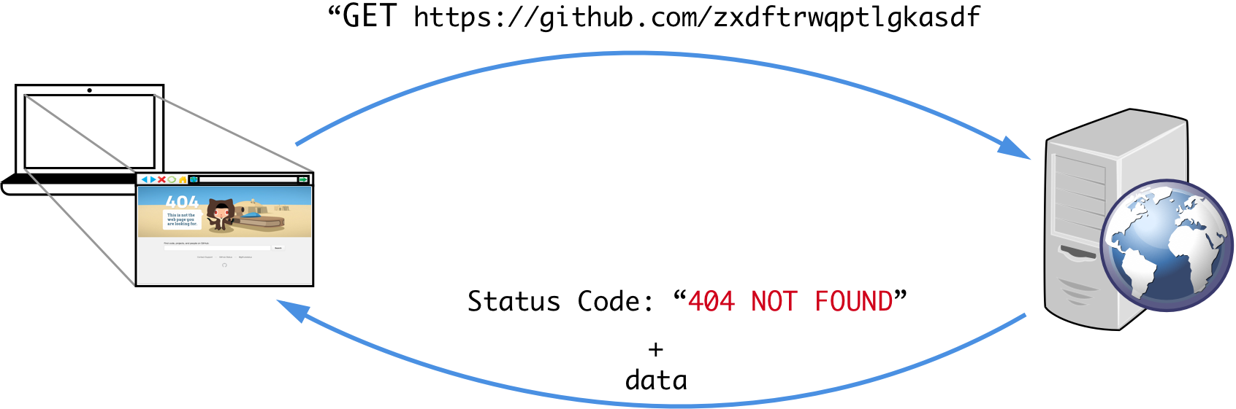
Notes:
So (if you like) open your web browsers and try typing github.com/{bunch of nonsense characters} and hit Enter
You’ll see an 404 error page, right?
You’re seeing this because the server couldn’t find the page you were looking for
So it responds with a 404 NOT FOUND status code
Also sends data to display the 404 page

Slide 28
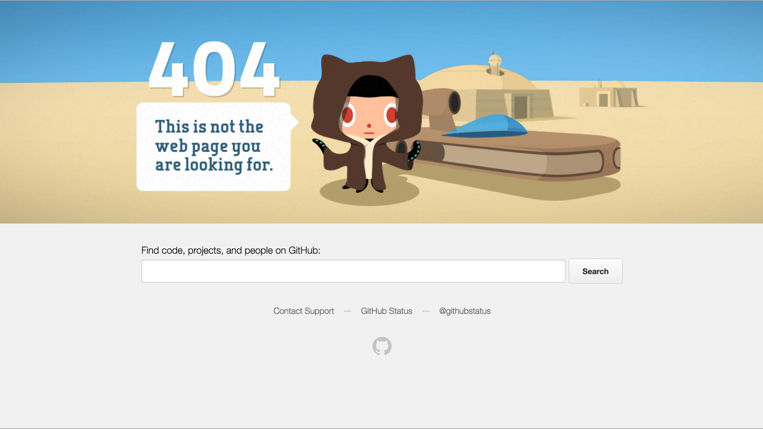
Notes:
So that’s a little primer on HTTP and how it relates to web development
Before I move on to what happens on the server side are there any questions?
Since this class is focused on FE web development, we’re going to gloss over a lot of the server-side of details
But there are a couple of things you should be aware of

Slide 29
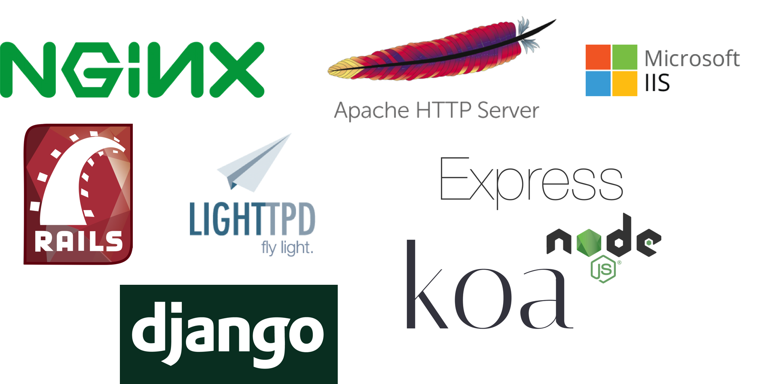
Notes:
The first thing is to clarify what a web server is
A web server is any computer on a network that “speaks HTTP” and responds to HTTP requests.
In order for a computer to be able to speak HTTP, it needs to have specialized web server software installed and running.
Pictured above: Logos of various web server software logos
There are lots of them, but these are just a few popular ones
So, let’s take a quick look at the Request-Response picture now with web server software included

Slide 30
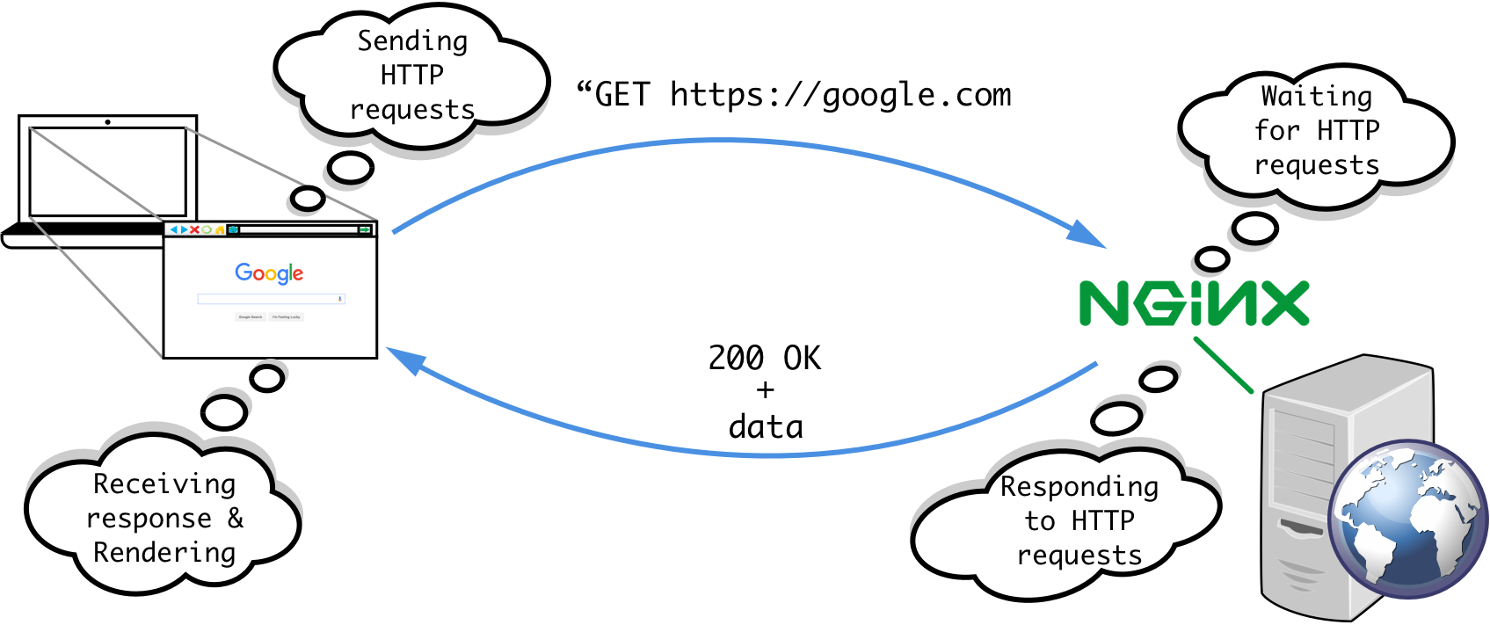
Notes:
So, this should look pretty familiar by now
Example
Web browser initiates HTTP request
The web server software is running on the server computer and is waiting for incoming requests (like a goalie waiting for someone to kick the ball at her)
And of course it responds to the web browser as we’re used to seeing
So, in way, it’s really two pieces of software talking to one another: browser and web server software
Questions?
There’s another important part of a web application’s back-end that you might want to be aware of: databases

Slide 31
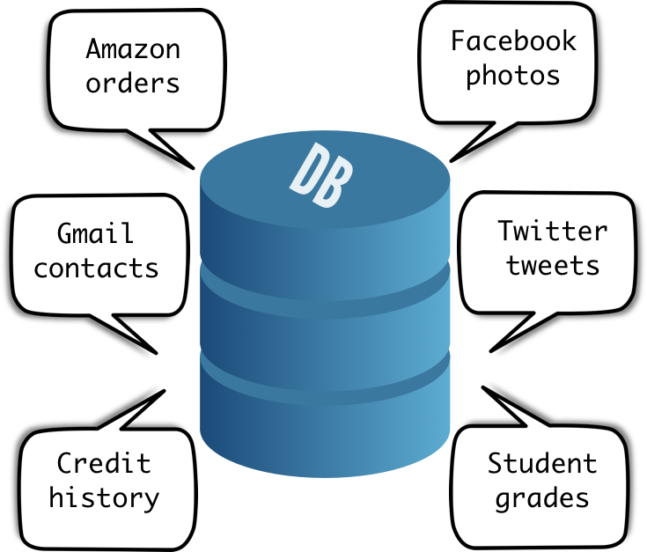
Notes:
A database is simply a place to store data for later use.
Here are some examples of the types of things DBs store
So, what does that look like in our Request-Response cycle?

Slide 32
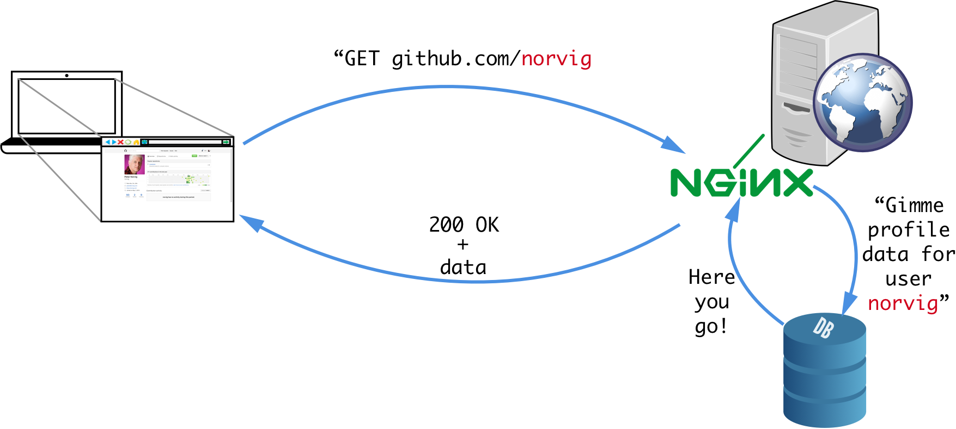
Notes:
Example
If you like, type in github.com/norvig (user’s profile page)
Browser sends GET request for github.com/norvig
Normally at this point We’d expect the server to respond, but I want to give a bit more detail here
The web server software itself, doesn’t actually hold the user’s (norvig) data
It asks the DB for the data associated with user:norvig
Incorporates the data into its response
Sends response back to browser for rendering
So, that’s a very basic request-response cycle showing a simplified full-stack web application.
Any questions?
Break before moving on to FE?

Slide 33
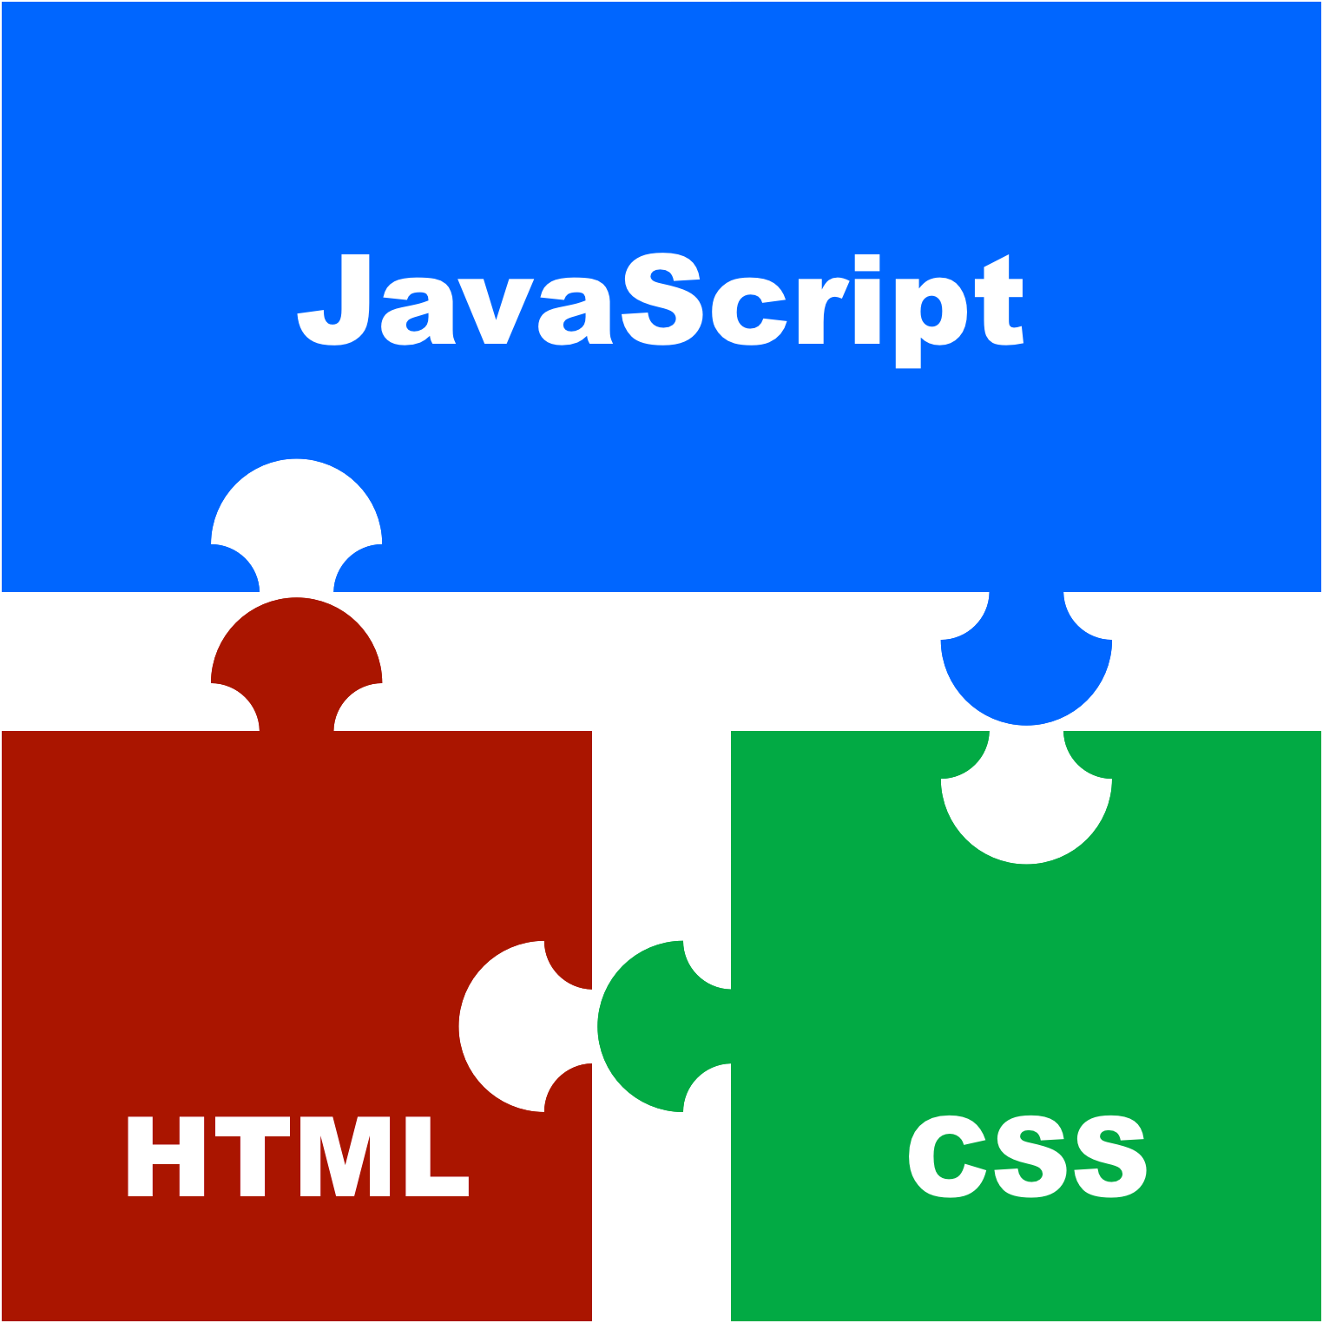
Client Side Technologies
Notes:
The client-side (or front-end) part of a web application is just the part that runs within your web browser on your computer.
The main client-side web technologies are HTML, CSS, and Javascript.
These are things the browser understands and uses to display web apps.
Professional client-side web developers use many other tools and technologies, but most of them are based on one or more of these foundational technologies.

Slide 34
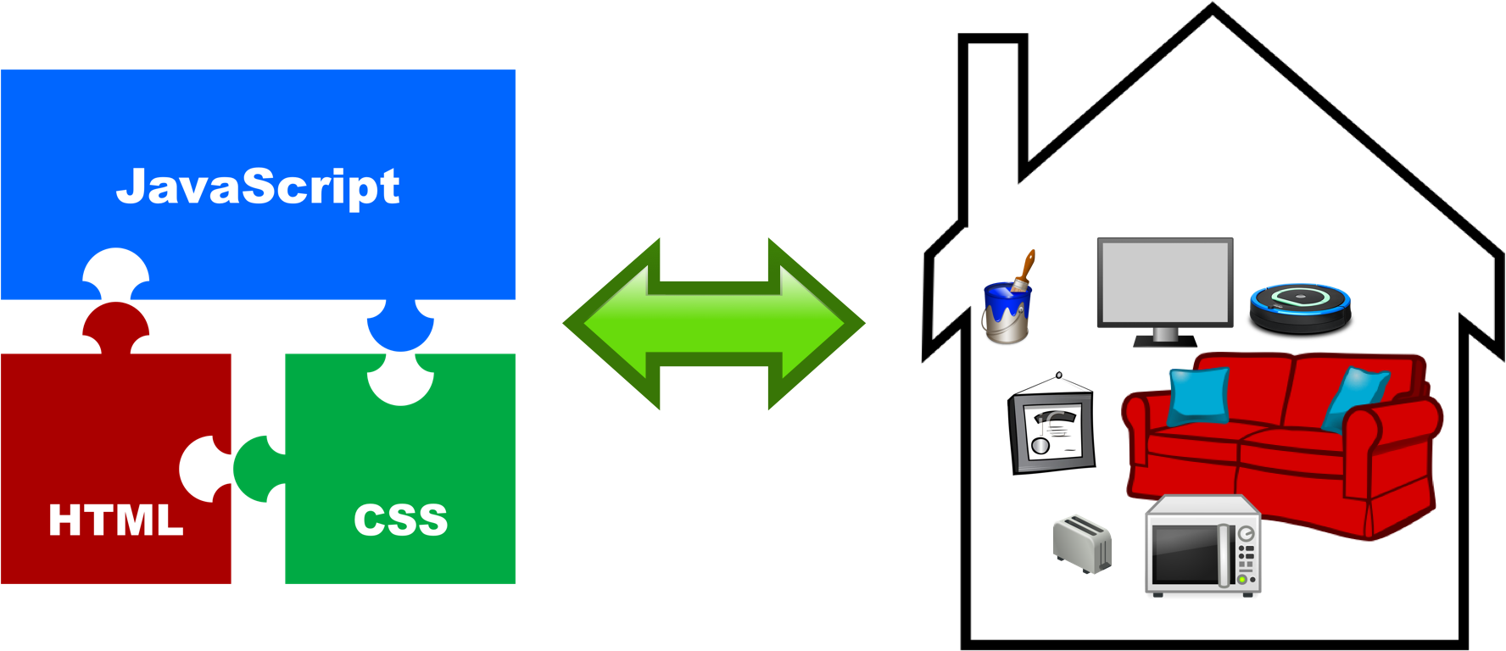
Let’s Build a House
Notes:
To help us understand the roles of each of these technologies and how they fit together…
I’d like to make an analogy.
Let’s compare building a web application to building a house.

Slide 35
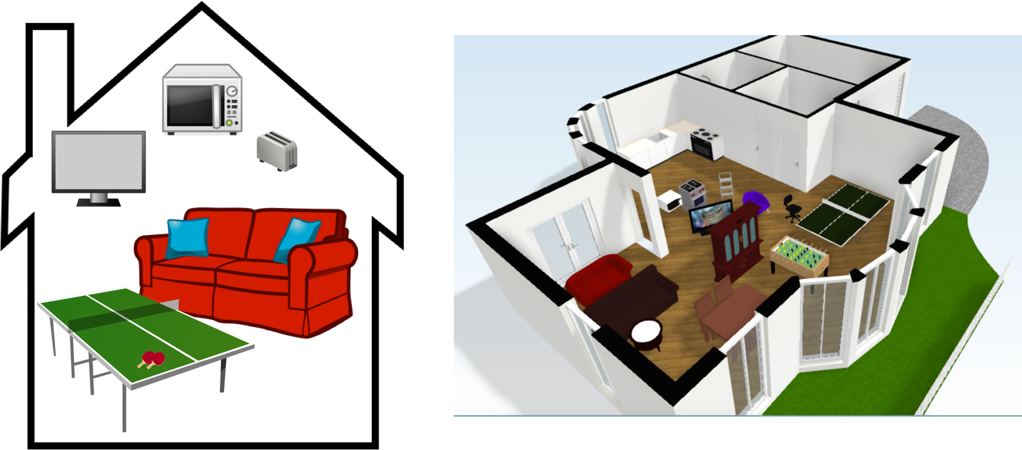
HTML
HyperText Markup Language
Notes:
HTML (HyperText Markup Language) is a language used to describe the structure and content of web applications.
In other words, you use HTML to create the frame of your web application and all of the elements (or things) in it.
In our house analogy
Creating an empty HTML page is like building an empty house
When you add elements to your HTML page, it’s like adding furniture and other things to the house
But you’re not yet concerned with arranging, styling, decorating anything
That’s not HTML’s role

Slide 36
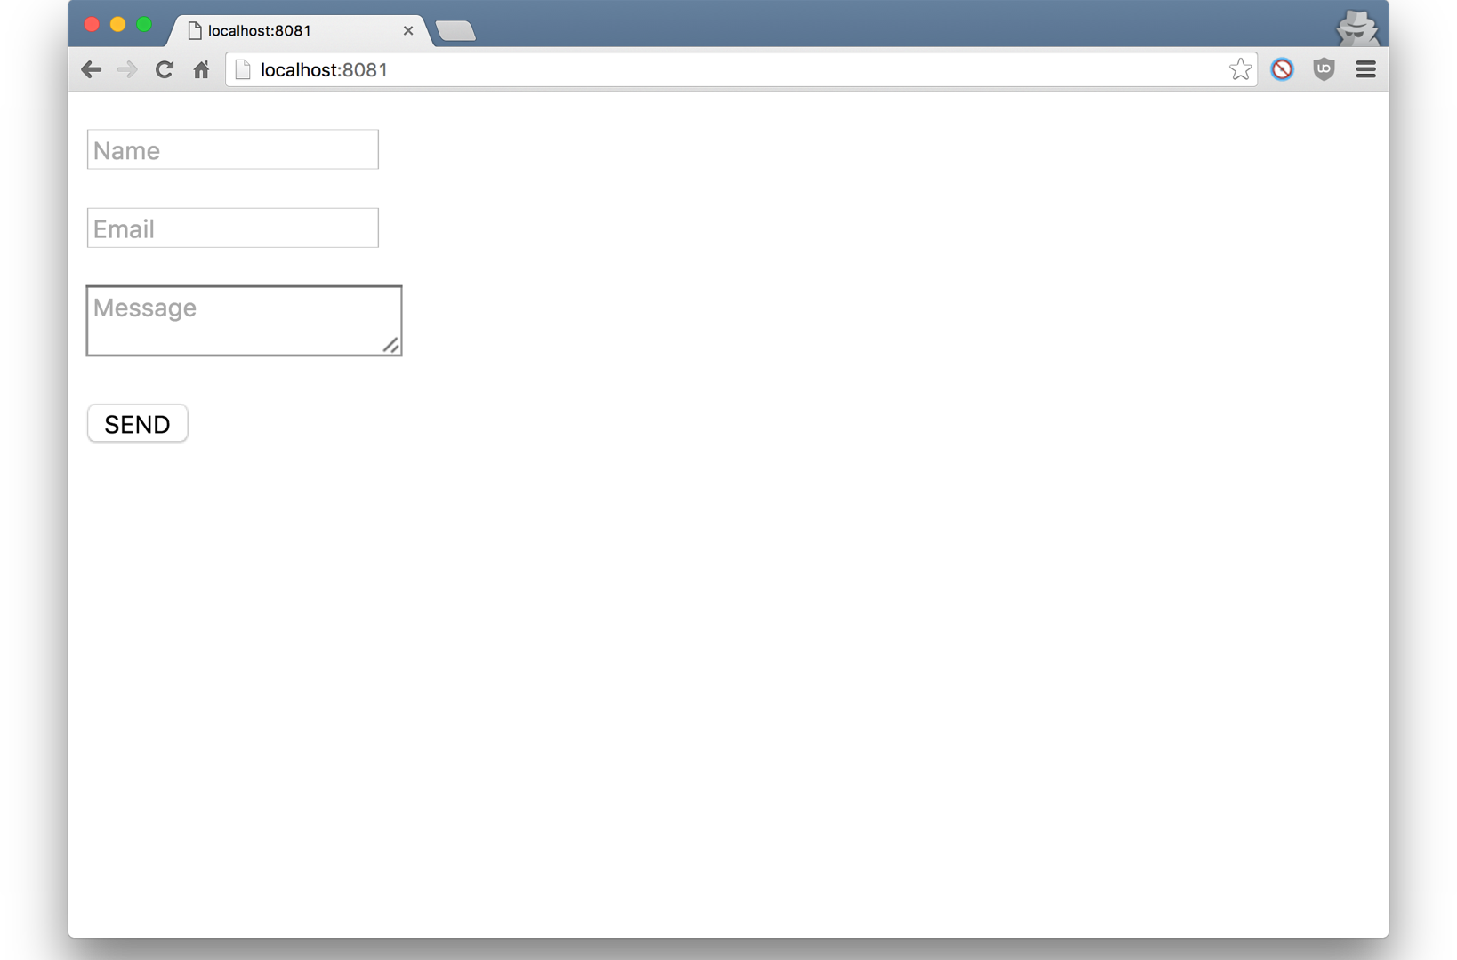
Notes:
Here’s an example of an simple HTML contact form
If it looks a bit plain – maybe boring - That’s expected.
Remember, we’re not concerned with color, positioning, or any other styles

Slide 37
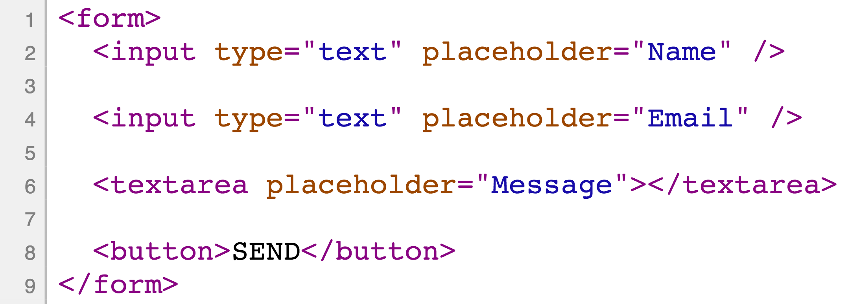
Notes:
So, here’s a sneak peek at some simplified HTML code.
This is more-or-less the code you’d write for that contact form.
Don’t worry too much about how it works, but see if you can match these “elements” to the parts of the contact form
Note the purple words you see (color not important, just how it’s highlighted) - nouns, things
Form
Input
Textarea
button
We will cover this in a lot more detail later on,
but I wanted to give a solid example showing HTML
Questions?
So, let’s move on to CSS

Slide 38
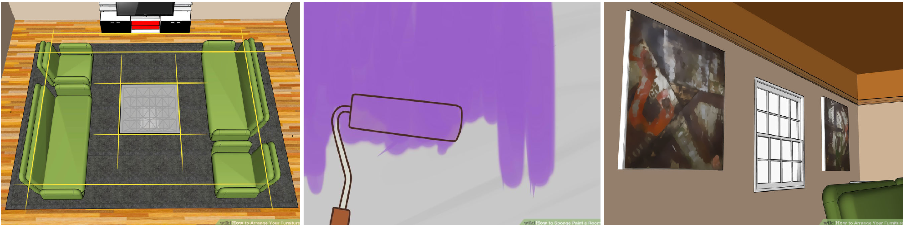
CSS
Cascading Style Sheets
Notes:
CSS (Cascading Style Sheets) is language used to “style and position” your HTML in the browser.
You can add CSS to change the way your application looks, how it’s laid out, and where things go on the page.
Examples
You can change color of text and other things.
You can set width, height, location of things
And tons more
House Analogy
Using CSS to add color to your page is like painting the walls of your home
Using CSS to add images is kind of like adding wall art to your house
Arranging your elements on the page is like positioning your furniture in the house.

Slide 39
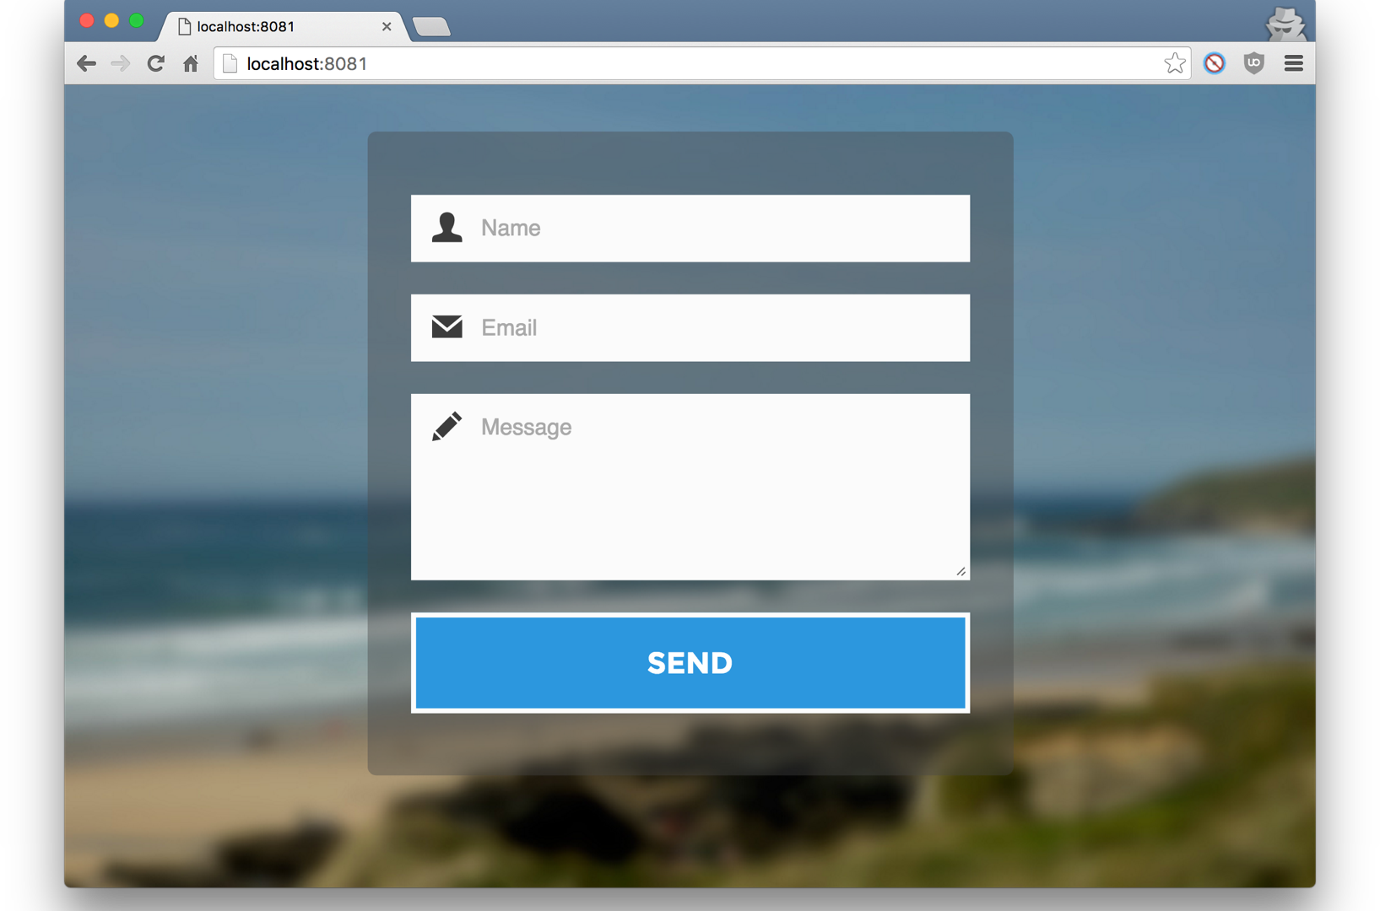
Notes:
I don’t have any CSS code examples to show you
CSS required: too complicated to be useful at this point
Instead, here are three styled versions of our contact form
(Pop back to unstyled contact form to compare).
This is a simple, but elegant version of the form
You can see that it’s the same structure, but with different styles
Styles to note
The form is centered
Has translucent grey border
Has blurred background image to give it a sense of depth
The button and form elements are all styled as well
Icons, etc

Slide 40
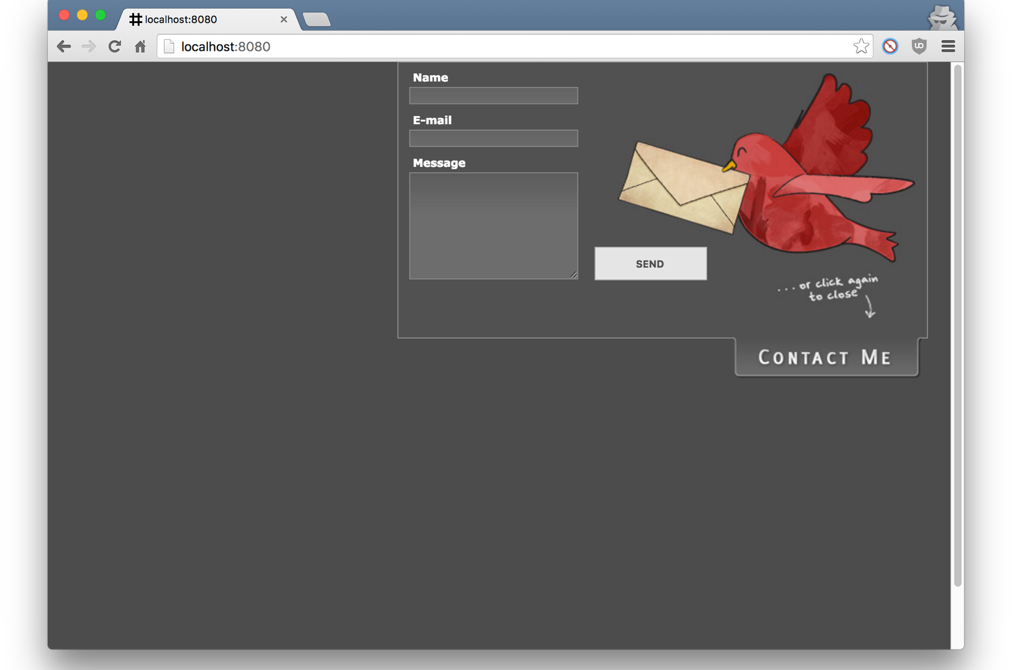
Notes:
Here’s another version.
More styles: background color, etc

Slide 41
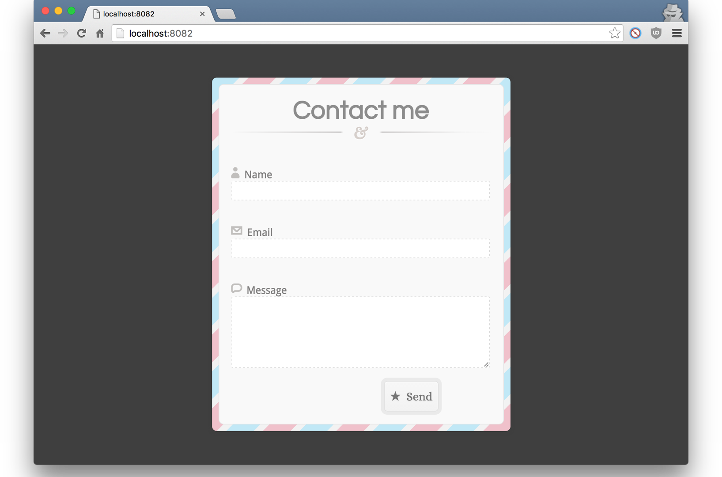
Notes:
So, here’s the last example (think you get the drill)
I hope these different versions of the same form give you a gut feel for the role of CSS in you web applications.
Questions?

Slide 42
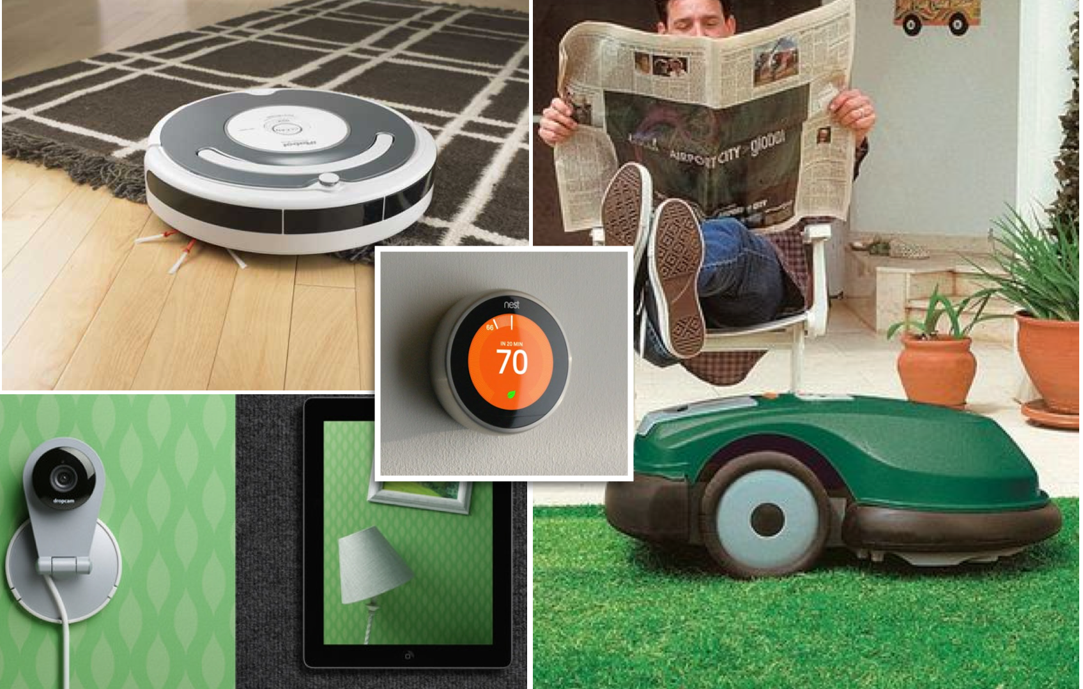
JavaScript
Notes:
JavaScript is simply a programming language that runs within web browsers.
It’s for adding dynamic behaviors to your app - things that HTML/CSS can’t do (mostly).
It’s what brings your web applications to life.
House Analogy
It's the moving pieces that automate your home.
JS programs are like “helpful robots.”
Examples
Roomba
Robot lawnmower (dangerous if Skynet takes over)
Nest
Dropcam
Ring (doorbell)

Slide 43

JavaScript
Live!
Notes:
If not already open, run workspace/overview-of-web-programming/start_all.sh
Show validation on two sites
Show “Celebration Fish” page
Show function for celebration page (maybe)

Slide 44
To Sum Up…
Networks: Connect Devices
Protocols: Aid Communication over
HTTP: The Web Protocol
Server Side: Web Servers and Databases
Client Side: HTML, CSS, JS
Notes:
We talked about
Networks: connect devices
Protocols: Aid communication using rules and common language
HTTP: The Web protocol and how it works
Web history
Server side (BE): including Web Servers and databases
And finally Client-side (FE) technologies HTML ,CSS, and JS
Questions?

